Slide 1
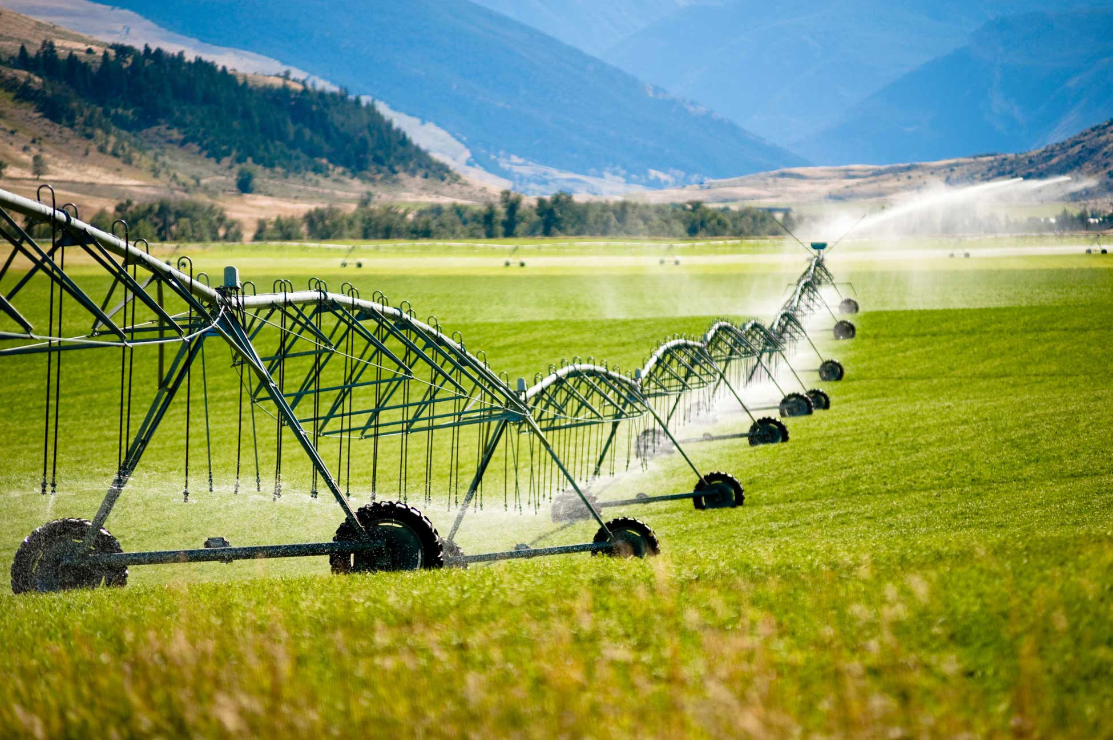
Irrigation Methods Water Usage in the United States and Techniques to Ensure Water Efficiency
Image (1)
Marcos Andrade
December 1st, 2022

Slide 2
Research Question and Background
How much freshwater is used in irrigation through 3 main irrigation methods
United States Geological Survey (USGS) 2015
Water usage is an important topic in actuality due to the scarcity of resources
“Irrigation has played a significant role in the development and economy of the United States. It was critical in the settlement of the West and agricultural reinvention after the Dust Bowl” (9)

Slide 3
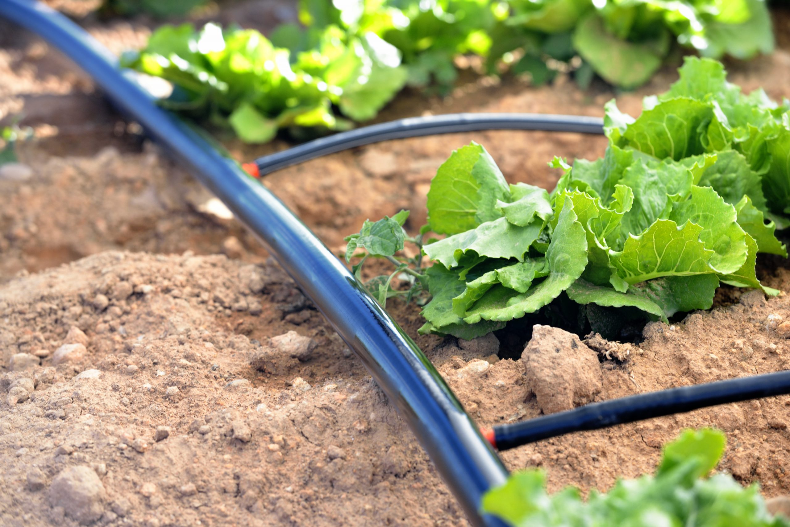
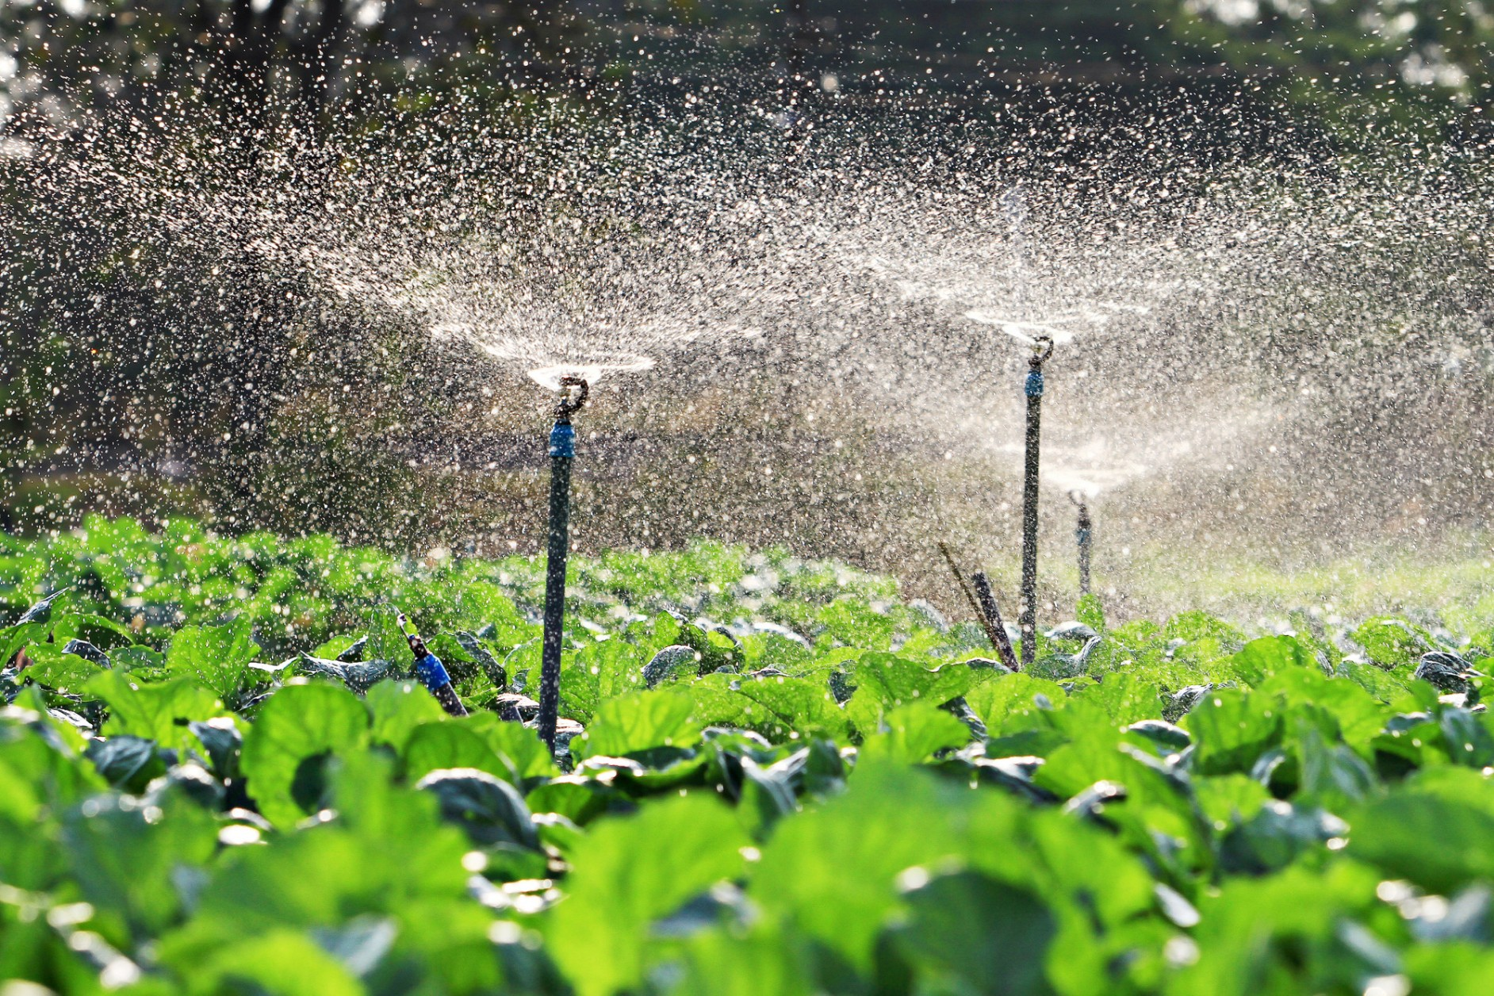
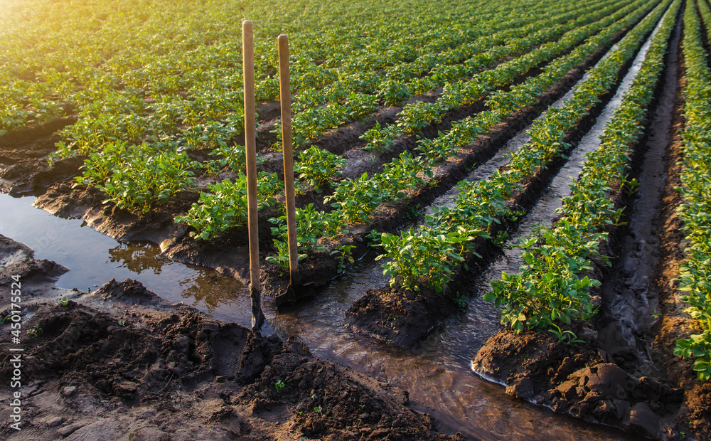
Irrigation Methods
Microirrigation
Sprinkler Irrigation
Image (2)
Image (3)
Flood Irrigation
Surface Irrigation
Furrow Irrigation
Gravity Irrigation
Image (4)

Slide 4
Important Considerations
“Irrigation water use is defined as water applied by an irrigation system to assist crop and pasture growth, or to maintain vegetation on recreational lands such as parks and golf courses” (8).
“Irrigation includes water that is applied for pre-irrigation, frost protection, chemical application, weed control, field preparation, crop cooling, harvesting, dust suppression, leaching of salts from the root zone, and conveyance losses” (8).
Initial hypothesis is that water usage will be consistent throughout all categories

Slide 5
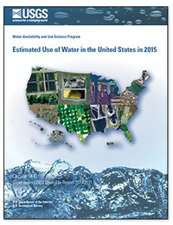
What dataset was used?
Data comes from field studies, interviews made to specialists and shared research. It comes directly from the United States Geological Survey (USGS)
Original dataset was contained in a 3225 rows (observations) x 141 columns (variables) table
Dependent variables were acres irrigated and water used per day
Explanatory variables were states and counties
Analyzed variables were categorical/quantitative
Image (5)

Slide 6
Methods
Tidy data
Original dataset had no mistakes in general, and good practices for data format were used (glossary, camel casing, one piece of data per cell)
Data is reproducible; using same methods can yield same results
Pivot tables were used, sum of data and graph insertion. Used excel with practices learned at class.

Slide 7
Results

Slide 8
General Irrigation Figure 1

Slide 9
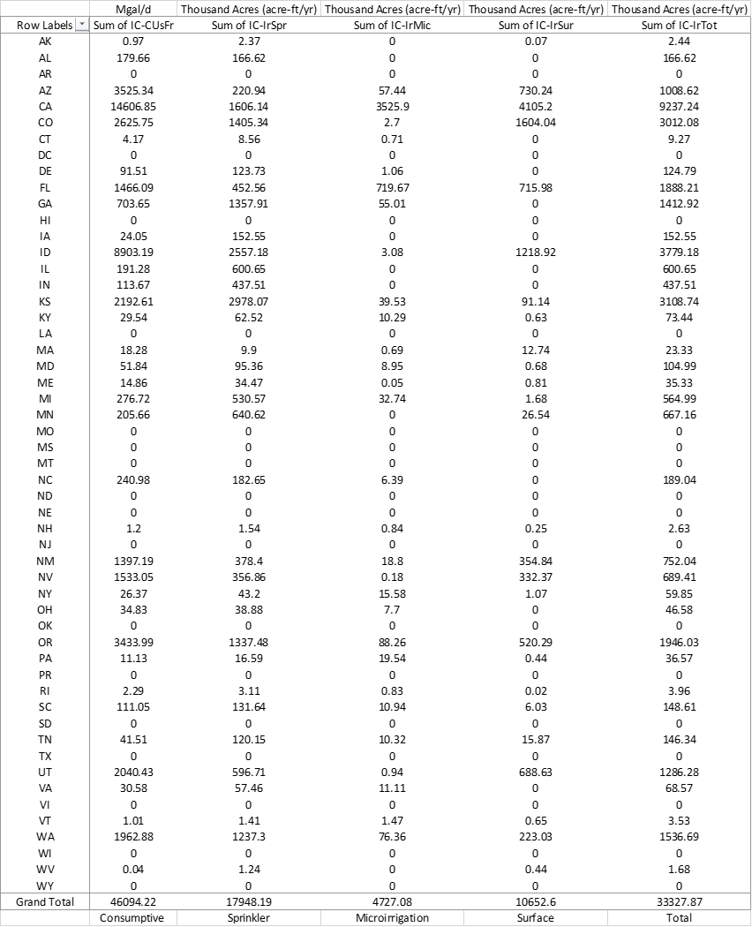
Irrigation of Crops
Figure 2

Slide 10
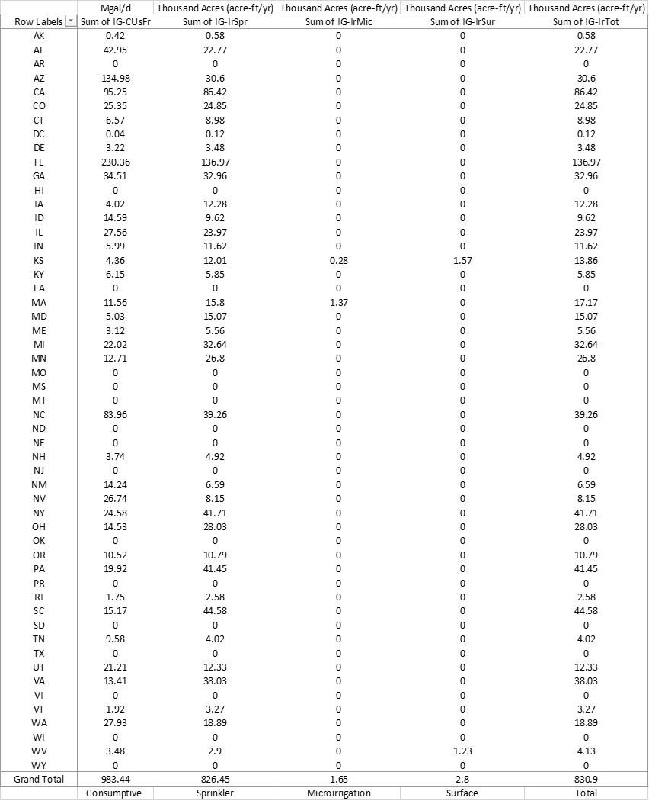
Irrigation-Golf Figure 3

Slide 11
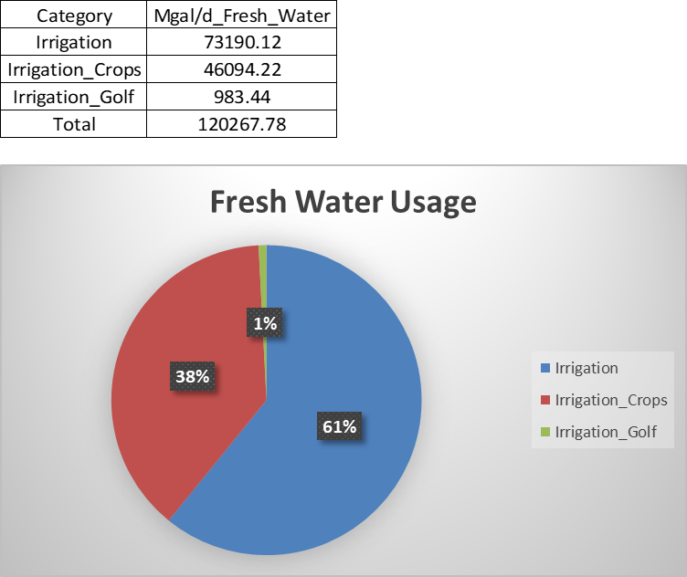
Figure 4

Slide 12
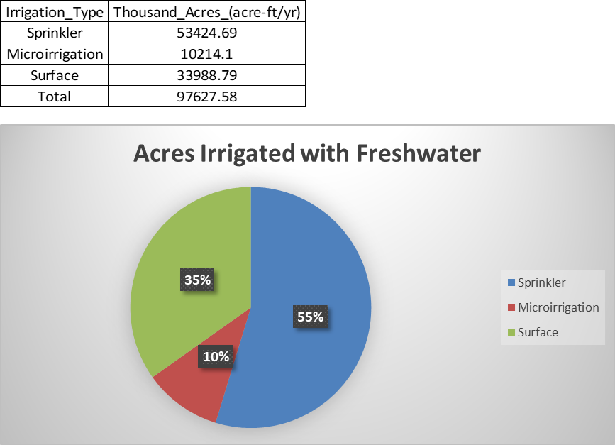
Figure 5

Slide 13
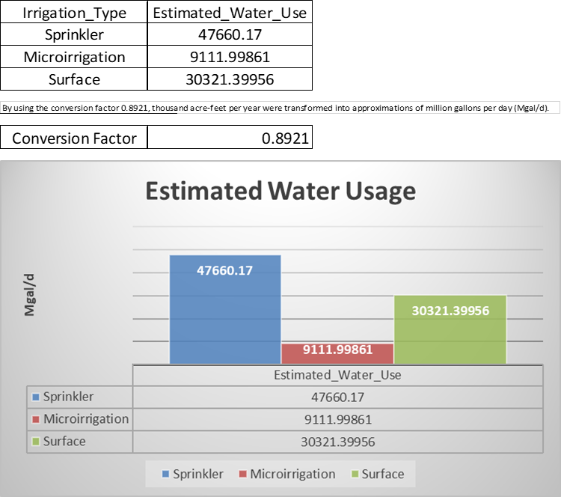
Figure 6

Slide 14
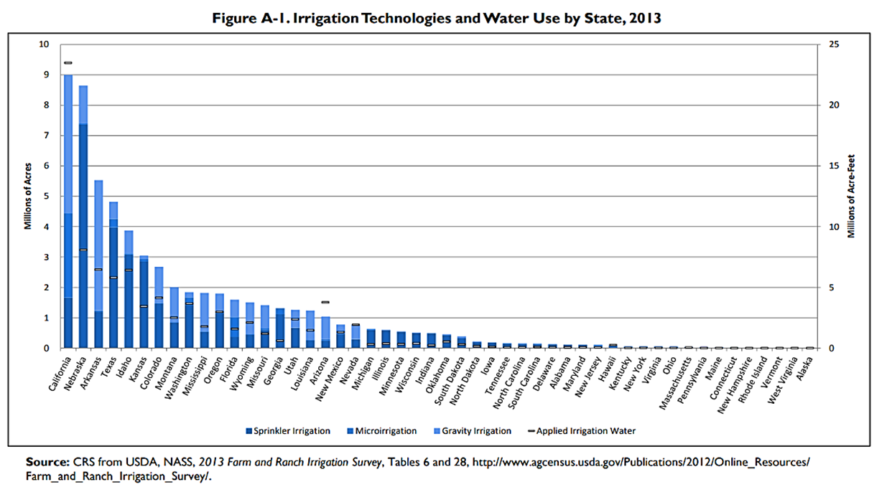
Figure 7 (9)
Congressional Research Service

Slide 15
Techniques to Ensure Water Efficiency
Scheduled Irrigation
Sedimentation Basins
Plan Acreage Under Irrigation
Deficit Irrigation
Oregon State University (2)

Slide 16
Discussion
Definition for multiple irrigation methods
Confirmed that data align for the most part with these water usage estimations
Discovered multiple irrigation efficiency practices
Interesting that even efficient methods can still be improved
Awareness in taking care of water in all aspects

Slide 17
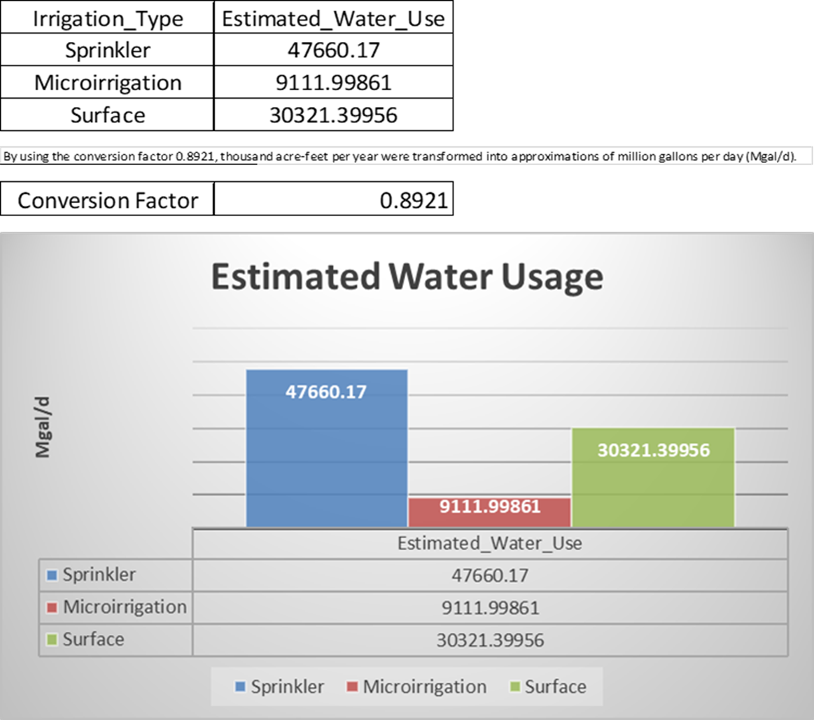
Conclusion
Sprinkler = 400 gph (6)
Microirrigation = 30 gph (6)
Surface = 800 gph (7)
Future studies about how to implement the previously mentioned irrigation efficiency practices can be done focusing attention prioritizing these three irrigation methods according to their water usage.

Slide 18
References
1. S. for a C. W. USGS, Estimated Use of Water in the United States County-Level Data for 2015 - ScienceBase-Catalog. www.sciencebase.gov (2017) Available at https://www.sciencebase.gov/catalog/item/get/5af3311be4b0da30c1b245d8 (November 5, 2022).
2. C. C. Shock, B. M. Shock, T. Welch, “Strategies for Efficient Irrigation Water Use” Available at https://catalog.extension.oregonstate.edu/em8783 (Oregon State University, 2013).
3. U.S. Bureau of Labor Statistics, Appendix D ‐ USPS State Abbreviations and FIPS Codes: U.S. Bureau of Labor Statistics. www.bls.gov (2005) Available at https://www.bls.gov/respondents/mwr/electronic-data-interchange/appendix-d-usps-state-abbreviations-and-fips-codes.htm (November 20, 2022).
4. UNICEF, Water Scarcity. UNICEF Available at https://www.unicef.org/wash/water-scarcity (2020).
5. United Nations, Water Scarcity. UN-Water Available at https://www.unwater.org/water-facts/water-scarcity (2021).
6. A. Yasalonis, Micro-Irrigation: A Water Saving Alternative. UF/IFAS Extension Polk County (2019) Available at https://blogs.ifas.ufl.edu/polkco/2019/07/10/micro-irrigation-a-water-saving-alternative/ (November 26, 2022).
7. ScienceDirect, Furrow Irrigation - Agricultural Water Management, 2002. www.sciencedirect.com (2005) Available at https://www.sciencedirect.com/topics/earth-and-planetary-sciences/furrow-irrigation (November 24, 2022).
8. C. A. Dieter, et al., Estimated use of water in the United States in 2015. pubs.er.usgs.gov, 76 (2018) Available at https://pubs.er.usgs.gov/publication/cir1441.
9. M. Stubbs, “Irrigation in U.S. Agriculture: On-Farm Technologies and Best Management Practices Megan Stubbs Specialist in Agricultural Conservation and Natural Resources Policy” (2016) Available at https://www.everycrsreport.com/reports/R44158.html (November 10, 2022).
10. E. BLAKEMORE, Why Puerto Rico has debated U.S. statehood since its colonization. History (2020) Available at https://www.nationalgeographic.com/history/article/puerto-rico-debated-statehood-since-colonization (November 28, 2022).

Slide 19
Image References
1. W1. Water Footprint Calculator, Drip Irrigation (2022) (November 28, 2022).
2. AGRIVI Farm Business, Sprinkler Irrigation: Why Successful Farmers Use It (2022) (November 29, 2022).
3. GESTIRIEGO, Tuberías de Microirrigación (2022) (November 29, 2022).
4. Andrii Yalanskyi, Potato plantation watering management (2022) (November 29, 2022).
5. USGS, Estimated use of water in the United States in 2015 (2015) (November 28, 2022).
6. SurveyLegend, How to Use Open-Ended Survey Questions +25 Examples (2020) (November 28, 2022).

Slide 20

Questions
Image (6)

